Slide 1
Multiplicative relationships in context
Understanding multiplicative relationships: fractions and ratio

Slide 2
how to use Oak lessons

Slide 3
I can appreciate that any two numbers can be connected via a multiplicative relationship.

Slide 4
A ratio shows the relative sizes of 2 or more values and allows you to compare a part with another part in a whole.

Slide 5

Multiplicative relationships in context
Multiplicative relationships in context
Converting money

Slide 6

Multiplicative relationships in context
How many multiplicative relationships can you see between these ingredients?
Number of smoothies | Slices of apple | Slices of banana | Milk (ml) | Yoghurt (ml)
1 | 8 | 4 | 100 | 200

Slide 7
Multiplicative relationships in context
Here are some examples,
Number of smoothies × 8 = Slices of apple
Slices of apples × 0.5 = Slices of banana
Slices of banana × 25 = Amount of milk
Slices of banana × 50 = Amount of yoghurt
Number of smoothies | Slices of apple | Slices of banana | Milk (ml) | Yoghurt (ml)
1 | 8 | 4 | 100 | 200

Slide 8
Multiplicative relationships in context
Here are some examples,
Does this multiplicative relationship change if we look at 3 smoothies?
Number of smoothies × 8 = Slices of apple
Slices of apples × 0.5 = Slices of banana
No, the multiplicative relationship remains the same or constant for the parts in the ratio.
Slices of banana × 25 = Amount of milk
Slices of banana × 50 = Amount of yoghurt
Number of smoothies | Slices of apple | Slices of banana | Milk (ml) | Yoghurt (ml)
1 | 8 | 4 | 100 | 200
3 | 24 | 12 | 300 | 600

Slide 9

Multiplicative relationships in context
There are lots of ways to show multiplicative relationships when using ratio tables.
What multiplicative relationships can you use to fill in this table?
Eggs | Sugar
2 | 3
 | 9
10
7
×1.5
×1.5
6
×1.5
15
×1.5
10.5

Slide 10
Multiplicative relationships in context
There are lots of ways to show multiplicative relationships when using ratio tables.
What multiplicative relationships can you use to fill in this table?
Eggs | Sugar
2 | 3
 | 9
10
7
×3
×3
×5
6
×5
×3.5
15
×3.5
10.5

Slide 11
Multiplicative relationships in context
Here is a recipe for vegetable soup.
C | P | W | S
8 | 4 | 200 | 2
8 carrots
4 potatoes
200 ml water
2 stock cubes
16 | 8 | 400 | 4
Andeep used: 10 carrots, 5 potatoes, 400 ml water, 1 stock cube
Andeep made mistakes when making the soup and is trying to fix it so the ratio is correct. What is the least amount of ingredients he could add to correct the ratio? (assuming you can only have integer amounts of each ingredient)
+ 6 carrots
+ 3 potatoes
+ 3 stock cubes

Slide 12
Multiplicative relationships in context
Here is a recipe for vegetable soup.
C | P | W | S
8 | 4 | 200 | 2
8 carrots
4 potatoes
200 ml water
2 stock cubes
40
40 | 20 | 1000 | 10
Jun used: 39 carrots, 19 potatoes, 1000 ml water, 6 stock cube
Jun has also some made mistakes when making the soup and is trying to fix it so the ratio is correct. What is the least amount of ingredients he could add to correct the ratio? (assuming you can only have integer amounts of each ingredient)
1 carrot
1 potato
4 stock cubes

Slide 13
Multiplicative relationships in context
1) Fill in the table knowing the following multiplicative relationships:
a) Number of eggs × 75 = Sugar
b) Flour is twice as many grams as butter
c) Butter × 1.5 = Sugar
Butter (g) | Flour (g) | Eggs | Sugar (g)
100 | 200 | 2 | 150
400 | 800 | 8 | 600
500 | 1000 | 10 | 750

Slide 14
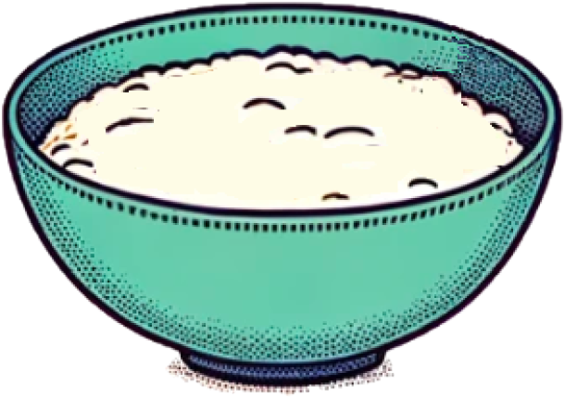
Multiplicative relationships in context
2) Most bread doughs start with flour and water. To make chapati, for every two cups of flour, you add one cup of water. To make pizza base, for every three cups of flour, you add two cups of water.
In each bowl, is it chapati dough, pizza base dough, or neither?
a)
d)
b)
e)
c)
f)
9 cups of flour
6 cups of water
12 cups of flour
8 cups of water
12 cups of flour
6 cups of water
18 cups of flour
12 cups of water
24 cups of flour
12 cups of water
24 cups of flour
18 cups of water

Slide 15
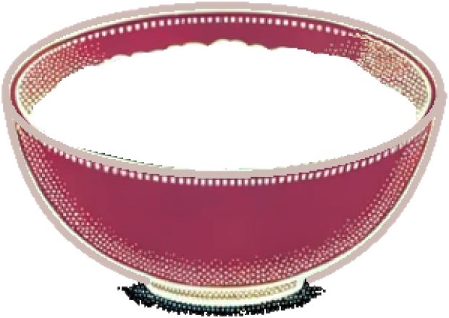
Multiplicative relationships in context
3) To make the perfect meringue, for every three eggs you add 150 g sugar. What is the minimum needed to add to each mixture below to make the meringue perfect?
a)
d)
b)
e)
c)
200 g sugar
6 eggs
450 g sugar
7 eggs
400 g sugar
9 eggs
500 g sugar
9 eggs
500 g sugar
10 eggs

Slide 16
Multiplicative relationships in context
1) Fill in the table knowing the following multiplicative relationships:
a) Number of eggs × 75 = Sugar
b) Flour is twice as many grams as butter
c) Butter × 1.5 = Sugar
Butter (g) | Flour (g) | Eggs | Sugar (g)
100 | 200 | 2 | 150
400 | 800 | 8 | 600
500 | 1000 | 10 | 750

Slide 17
Multiplicative relationships in context
2) To make chapati, for every two cups of flour, you add one cup of water.
To make pizza base, for every three cups of flour, you add two cups of water.
Dough | Cups of flour | Cups of water
1 chapati | 2 | 1
1 pizza | 3 | 2
×4.5
×4.5
9
4.5 chaptis | 9 | 4.5
×3
×3
3 pizzas | 9 | 6
9
a)
9 cups of flour
6 cups of water
Pizza

Slide 18
Multiplicative relationships in context
2) To make chapati, for every two cups of flour, you add one cup of water.
To make pizza base, for every three cups of flour, you add two cups of water.
Dough | Cups of flour | Cups of water
1 chapati | 2 | 1
1 pizza | 3 | 2
×6
×6
12
6 chaptis | 12 | 6
×4
×4
4 pizzas | 12 | 8
12
b)
c)
12 cups of flour
8 cups of water
12 cups of flour
6 cups of water
Pizza
Chapati

Slide 19
Multiplicative relationships in context
2) To make chapati, for every two cups of flour, you add one cup of water.
To make pizza base, for every three cups of flour, you add two cups of water.
Dough | Cups of flour | Cups of water
1 chapati | 2 | 1
1 pizza | 3 | 2
×9
×9
18
9 chaptis | 18 | 9
×6
×6
6 pizzas | 18 | 12
18
d)
18 cups of flour
12 cups of water
Pizza

Slide 20
Multiplicative relationships in context
2) To make chapati, for every two cups of flour, you add one cup of water.
To make pizza base, for every three cups of flour, you add two cups of water.
Dough | Cups of flour | Cups of water
1 chapati | 2 | 1
1 pizza | 3 | 2
×12
×12
24
12 chaptis | 24 | 12
×8
×8
24
8 pizzas | 24 | 16
e)
f)
24 cups of flour
12 cups of water
24 cups of flour
18 cups of water
Chapati
Neither

Slide 21
Multiplicative relationships in context
3) For every three eggs you add 150 g sugar.
a)
b)
c)
200 g sugar
6 eggs
450 g sugar
7 eggs
400 g sugar
9 eggs
Recipe ×2:
300 g sugar
6 eggs
Recipe ×3:
450 g sugar
9 eggs
Recipe ×3:
450 g sugar
9 eggs
Add 100 g sugar
Add 2 eggs
Add 50 g sugar

Slide 22
Multiplicative relationships in context
3) For every three eggs you add 150 g sugar.
500 g sugar
9 eggs
500 g sugar
10 eggs
Recipe x4:
600 g sugar
12 eggs
Sugar ÷ 50 = eggs
500 g sugar
10 eggs
No change. It is perfect!
Add 200 g sugar
Add 3 eggs
Add 1 egg

Slide 23
Multiplicative relationships in context
Multiplicative relationships in context
Converting money

Slide 24
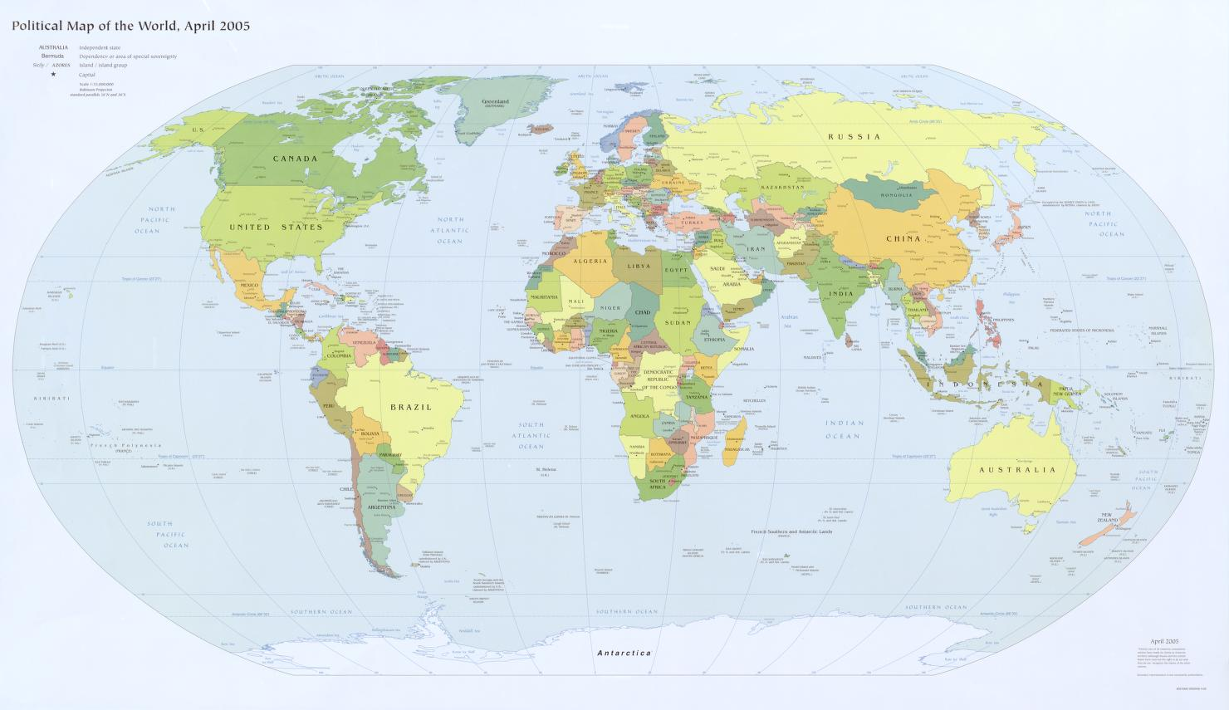
Converting money
There are different currencies across the world.
Do you know the currencies used in these countries?
Japan
USA
Yen
¥
Dollars
$
Spain
China
Euros
€
Renminbi
¥
Argentina
Peso
$
India
Rupee
₹
Library of Congress, Geography and Map Division.

Slide 25
Converting money
There are so many different currencies in the world, it is important to know how to convert between them.
Converting money into another currency is proportional and uses a multiplier.

Slide 26
Converting money
There are so many different currencies in the world, it is important to know how to convert between them.
Converting money into another currency is proportional and uses a multiplier.
For example, what multiplicative relationships can you use to fill in this table?
Pounds (£) | USA dollars ($)
1 | 1.25
 | 3.75
10
×3
×3
×10
3
×10
12.50

Slide 27
Converting money
There are so many different currencies in the world, it is important to know how to convert between them.
Converting money into another currency is proportional and uses a multiplier.
For example, what multiplicative relationships can you use to fill in this table?
Pounds (£) | USA dollars ($)
1 | 1.25
 | 3.75
10
×1.25
× 1.25
3
×1.25
12.50

Slide 28

Converting money
Every £1 converts to €1.16
Which of the following show the same ratio?
Pounds (£) | Euros (€)
1 | 1.16
£20 converts to €23.20
×20
×20
×110
20
£110 converts to €127.60
23.20
×110
÷4
÷4
110
127.60
€0.29 converts to £0.25
0.25
0.29

Slide 29
Converting money
Every £1 converts to €1.16
Which of the following show the same ratio?
Pounds (£) | Euros (€)
1 | 1.16
£20 converts to €23.20
× 1.16
20
23.20
£110 converts to €127.60
110
× 1.16
127.60
× 1.16
€0.29 converts to £0.25
0.25
0.29
You could have also got the answers using the multiplicative relationship between the parts.

Slide 30



Converting money
Three shops provide three different conversions.
Which is the best deal? Explain.
Shop A
For every £2
we give you €2.28
Shop B
For every £12
we give you €24
Shop C
For every £30
we give you €45
Pounds (£) | Euros (€)
2 | 2.28
Pounds (£) | Euros (€)
12 | 24
Pounds (£) | Euros (€)
30 | 45
×1.14
× 2
× 1.5
Pounds × 1.14 = Euros
Pounds × 2 = Euros
Pounds × 1.5 = Euros

Slide 31
Converting money
Shop B is the best because the multiplier from pounds to euros is the greatest. You get more euros per pound.
Shop A
For every £2
we give you €2.28
Shop B
For every £12
we give you €24
Shop C
For every £30
we give you €45
Pounds (£) | Euros (€)
2 | 2.28
Pounds (£) | Euros (€)
12 | 24
Pounds (£) | Euros (€)
30 | 45
×1.14
× 2
× 1.5
Pounds × 1.14 = Euros
Pounds × 2 = Euros
Pounds × 1.5 = Euros

Slide 32
Converting money
Fill in the currency conversion table using the following ratio:
Euros (€) | USA dollars ($)
1 | 1.08
11 | 11.88
20 | 21.60
0.5 | 0.54
50 | 54
150 | 162

Slide 33

Converting money
2) A group of three friends are going on holiday. They all exchange some pounds for euros.
I got €120 for £100
I got €30 for £20
I got €90 for £60
Sofia
Laura
Sam
a) Who got the best deal?
b) Andeep decided to come along too and exchanged €110 for £100. Whose deal was it most similar to?

Slide 34
Converting money
Fill in the currency conversion table using the following ratio:
Euros (€) | USA dollars ($)
1 | 1.08
11 | 11.88
20 | 21.60
0.5 | 0.54
50 | 54
150 | 162

Slide 35
Converting money
2) Who got the best deal?
Laura and Sam got the best deal.
I got €120 for £100
I got €30 for £20
I got €90 for £60
Sofia
Laura
Sam
Pounds (£) | Euros (€)
100 | 120
Pounds (£) | Euros (€)
20 | 30
Pounds (£) | Euros (€)
60 | 90
×1.2
×1.5
×1.5
120 ÷ 100 = 1.2
30 ÷ 20 = 1.5
90 ÷ 60 = 1.5
Pounds × 1.2 = Euros
Pounds × 1.5 = Euros
Pounds × 1.5 = Euros

Slide 36
Converting money
2) A group of three friends are going on holiday. They all exchange some pounds for euros.
I got €120 for £100
I got €30 for £20
I got €90 for £60
Sofia
Laura
Sam
Pounds × 1.2 = Euros
Pounds × 1.5 = Euros
Pounds × 1.5 = Euros
b) Andeep decided to come along too and exchanged €110 for £100. Whose deal was it most similar to?
110 ÷ 100 = 1.1 This is most similar to Sofia.

Slide 37
Multiplicative relationships in context
Recognising that ratio shows the relative sizes of 2 or more values and it allows you to compare a part with another part in a whole is important.
The multiplicative relationship between the parts is constant for things in the same ratio.
This multiplicative relationship applies to lots of real life contexts, including converting currencies.

Slide 38

© Oak National Academy 2023.
Produced in partnership with Mathematics in Education and Industry.
Licensed on the Open Government Licence v3.0, except where otherwise stated. See Oak terms and conditions.

